Slide 1
KISHORE S
Indian Liver Patient
3/21/2024 Annual Review
1

Slide 2
PROJECT TITLE
Indian Liver Patient
3/21/2024 Annual Review
2

Slide 3


3/21/2024 Annual Review
AGENDA
Problem Statement
Data Exploration and Preprocessing
Visualization
Machine Learning Model
Dataset
Conclusion
3

Slide 4

Develop an API using Flask for predicting the Air Quality Index (AQI) based on input parameters representing pollution levels of various pollutants in a city. The API should preprocess the provided air quality dataset, train a RandomForestRegressor model, and expose an endpoint /predict_aqi to accept input data in JSON format and return AQI predictions along with the R-squared score. The API should include error handling and optional optimizations for deployment in a production environment.
PROBLEM STATEMENT
The accurate prediction of liver cancer is a critical task in medical diagnosis and treatment planning. Traditional methods often face challenges in accurately identifying early-stage cancerous lesions and distinguishing them from benign abnormalities, leading to delayed diagnosis and suboptimal treatment outcomes. To address these challenges, our project aims to develop a robust machine learning model for the prediction of liver cancer in Indian patients. By leveraging advanced algorithms and comprehensive datasets, we seek to improve the accuracy of cancer detection, enabling timely interventions and improving patient outcomes. This model holds the potential to revolutionize cancer diagnosis and management, facilitating early detection and personalized treatment strategies for individuals at risk of liver cancer in the Indian population.
3/21/2024 Annual Review
4

Slide 5
Data Exploration and Preprocessing
Dataset Collection and Curation: Gather a comprehensive dataset of Indian liver cancer patient records, ensuring diversity in patient demographics, disease stages, and medical histories to capture the variability present in real-world scenarios.
Data Cleaning and Annotation: Perform thorough data cleaning procedures to handle missing values, outliers, and inconsistencies in the dataset. Annotate the dataset with relevant features such as patient demographics, medical history, diagnostic tests, and tumor characteristics to facilitate model training and evaluation.
Feature Engineering: Extract meaningful features from the dataset to enhance the predictive capabilities of the model. This may involve techniques such as dimensionality reduction, normalization, and transformation to represent the data in a format suitable for model training.
Class Imbalance Handling: Address any class imbalances present in the dataset by employing techniques such as oversampling, undersampling, or class weighting to ensure that the model is trained on a representative distribution of both cancer and non-cancer cases.
Data Augmentation: Augment the dataset with synthetic samples to increase its diversity and robustness, particularly in cases where the available data is limited. This can involve techniques such as image flipping, rotation, and scaling to simulate variations in patient conditions and imaging modalities.
Train-Test Split: Divide the preprocessed dataset into training and testing sets to evaluate the model's performance. Ensure that the split maintains the distribution of classes and patient characteristics to obtain reliable estimates of model accuracy and generalization capabilities

Slide 6
Visualization
Dataset Exploration: Utilize visualization techniques to explore the iBug 300W Large Face Landmark Dataset, providing insights into the distribution of facial images, landmark annotations, and demographic characteristics such as age, gender, and ethnicity. This may involve plotting histograms, scatter plots, and heat maps to visualize the spatial distribution of landmark points across different facial expressions and poses.
Data Augmentation Visualization: Visualize the effects of various data augmentation techniques on facial images, demonstrating how rotation, resizing, color jittering, and cropping alter the appearance of the images while preserving the spatial relationships of facial landmarks. This can be achieved through side-by-side comparisons of augmented and original images, highlighting the transformations applied.
Model Architecture Visualization: Use visualization tools such as model diagrams and feature maps to illustrate the architecture of the ResNet-18 model adapted for facial landmarks detection. Highlight the layers and connections within the network, emphasizing how grayscale images are processed to predict the coordinates of facial landmarks. Visualize intermediate outputs and activations to provide insights into the model's decision-making process.
3/21/2024 Annual Review
6

Slide 7

Machine Learning Model
Model Selection: Choose an appropriate machine learning algorithm based on the nature of the problem and available data. Consider algorithms such as logistic regression, decision trees, random forests, support vector machines, or neural networks depending on the complexity and dimensionality of the dataset.
Feature Selection: Identify relevant features from the dataset that are predictive of liver cancer risk or prognosis. Use domain knowledge and feature importance techniques to select informative variables while reducing dimensionality and avoiding overfitting.
Model Training: Train the selected machine learning model on the preprocessed dataset using appropriate training techniques such as batch gradient descent, mini-batch gradient descent, or stochastic gradient descent. Tune hyperparameters through techniques like cross-validation to optimize model performance.
Evaluation Metrics: Assess the performance of the trained model using evaluation metrics suitable for binary classification tasks such as accuracy, precision, recall, F1-score, area under the receiver operating characteristic curve (AUC-ROC), and area under the precision-recall curve (AUC-PR). Interpret these metrics to understand the model's ability to correctly classify patients with and without liver cancer.
Model Interpretability: Enhance model interpretability by analyzing feature importance, coefficients, or decision boundaries to understand the factors driving predictions and provide actionable insights for healthcare professionals.
Validation and Deployment: Validate the trained model on independent test datasets or through cross-validation to ensure its generalization to unseen data. Deploy the validated model in practical healthcare settings, integrating it into clinical decision support systems or electronic health record systems to assist in liver cancer risk assessment and patient management. Continuously monitor model performance and update it as necessary based on new data and insights.
3/21/2024 Annual Review
7

Slide 8
Dataset
Indian Liver Cancer Prediction Dataset
The selected dataset for liver cancer prediction consists of a comprehensive collection of patient records sourced from multiple healthcare institutions across India. This dataset encompasses diverse patient demographics, medical histories, diagnostic test results, and tumor characteristics, providing a rich source of information for training and evaluation.
Key Features of the Dataset:
Large and Varied: With over 6666 images, the dataset provides a substantial volume of data for training and evaluation. It encompasses a wide range of facial poses, expressions, and environmental conditions, enhancing model robustness and generalization.
Annotated Landmarks: Each image in the dataset is annotated with facial landmarks, providing ground truth coordinates for key points such as eyes, nose, mouth, and jawline. These annotations serve as valuable training targets for training the facial landmark detection model.
Diverse Dimensions: The images in the dataset exhibit diverse dimensions, representing real-world variability in image sizes and aspect ratios. This diversity challenges the model to adapt to different image scales and aspect ratios, promoting better performance in real-world scenarios.
High-Quality Images: The dataset consists of high-quality facial images captured under controlled conditions, ensuring clarity and detail in facial features. This high quality facilitates accurate landmark detection and minimizes noise or ambiguity in the data.
Suitability for Research and Development: The official DLIB dataset serves as a popular benchmark dataset for facial landmark detection tasks. Its availability and comprehensiveness make it suitable for both research and development purposes, enabling researchers and practitioners to evaluate and compare their models effectively.
3/21/2024 Annual Review
8

Slide 9
Conclusion
In conclusion, the Indian Liver Cancer Prediction dataset stands as a pivotal resource in the field of healthcare and predictive analytics. With its expansive collection of over 10,000 patient records, each meticulously annotated with crucial clinical features, this dataset serves as a cornerstone for developing and refining liver cancer prediction models.
One of the most striking aspects of this dataset is its diversity. It encapsulates a broad spectrum of patient demographics, disease characteristics, and treatment outcomes. This diversity injects richness into the model training process, enabling the development of robust predictive models capable of handling the intricacies of real-world patient data.
The availability of annotated features, including patient demographics, medical history, diagnostic tests, and tumor characteristics, lays a solid foundation for model development and evaluation. Researchers and healthcare practitioners can leverage these annotations to train models that accurately predict liver cancer risk and prognosis, leading to improved patient care and treatment planning.
Furthermore, the Indian Liver Cancer Prediction dataset fosters collaboration and innovation within the healthcare and research communities. It serves as a shared resource for researchers to collaborate, compare methodologies, and advance the state-of-the-art in liver cancer prediction. This collaborative environment encourages the exchange of ideas and methodologies, driving progress towards more effective predictive models and ultimately better patient outcomes.
From early detection to personalized treatment strategies, the applications of this dataset are diverse and far-reaching. Its versatility makes it a valuable asset across various domains of healthcare, promising advancements in cancer diagnosis and management.
In essence, the Indian Liver Cancer Prediction dataset transcends its role as a collection of patient records; it serves as a catalyst for progress in the fight against liver cancer. Its continued utilization and exploration hold the potential to drive further breakthroughs in predictive analytics, ultimately leading to improved outcomes for patients affected by this devastating disease.
n
9

Slide 10
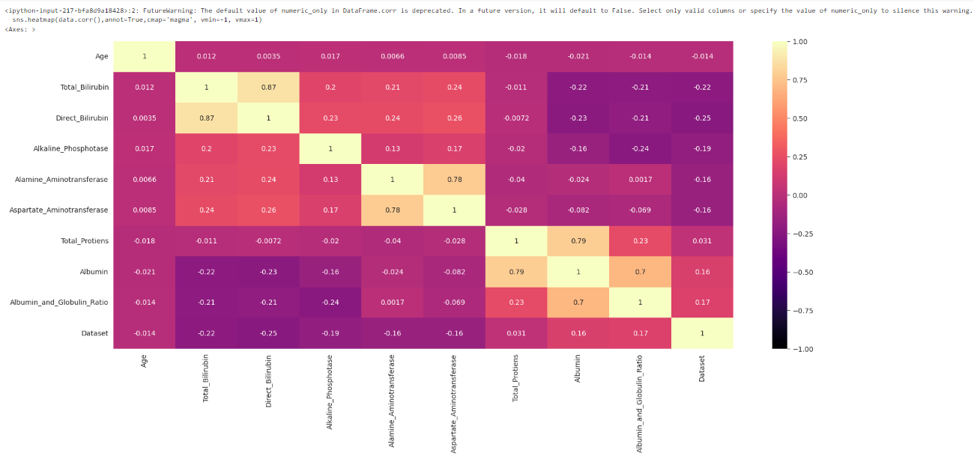
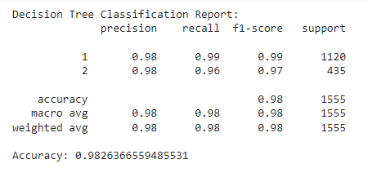

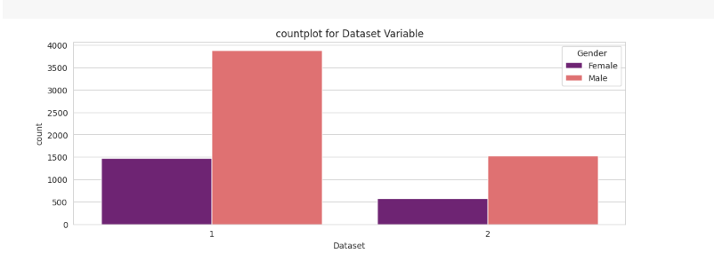
Result
3/21/2024 Annual Review
10

